Slide 1
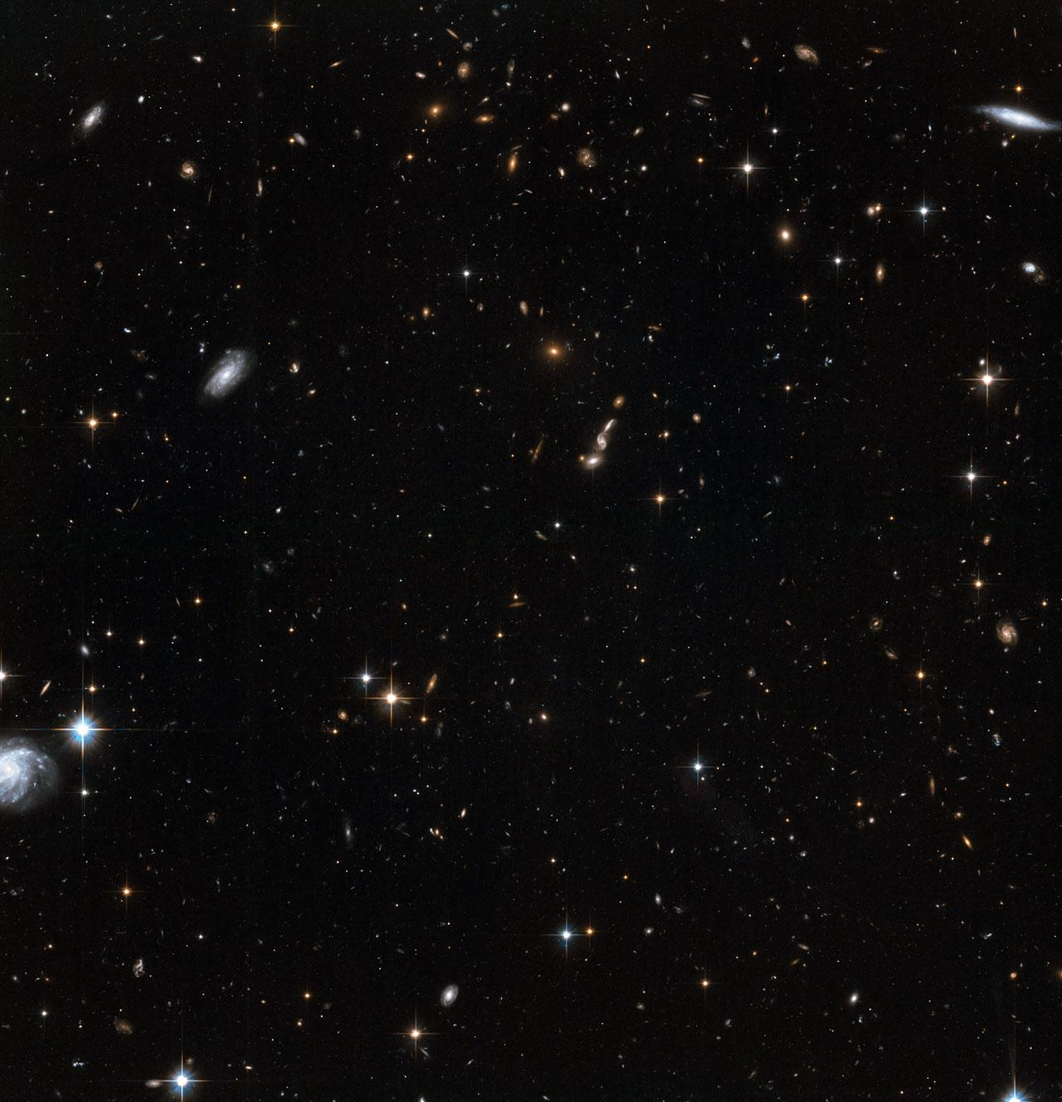
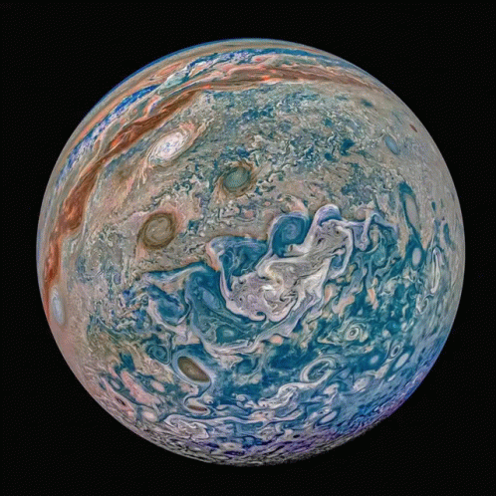
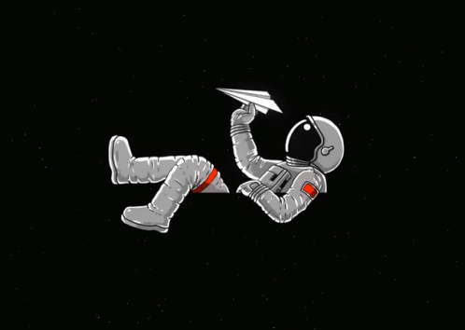

Analyzing the Discoveries of Exoplanets
Nicholas Stroupe
Capstone Project for Nashville Software School
Data Analytics DDA14
Notes:
Good morning/afternoon/evening, name/everyone. I am Nicholas Stroupe and I am with Nashville Software Schools DDA14. Today, I'm excited to share my capstone project on Exoplanets and their discovery methods. These are planets that orbit stars outside our solar system. Over the past few decades, astronomers have developed various methods to detect these distant worlds. In my analysis, I'll dive into 3 primary methods of discovery, examining the strengths and limitations of the various detection methods. The data I used for this project was collected from the Catalogue of Exoplanets on the Encyclopedia of Exoplanetary Systems. This encyclopaedia provides the latest detections and data announced by professional astronomers on exoplanetary systems.

Slide 2


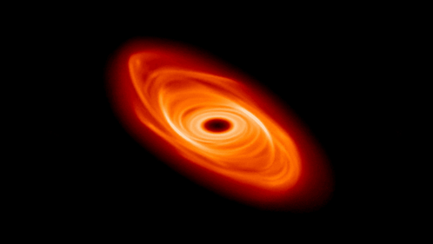
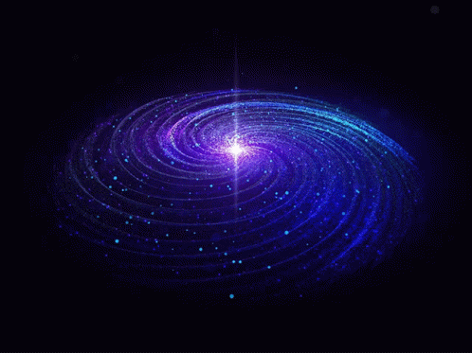
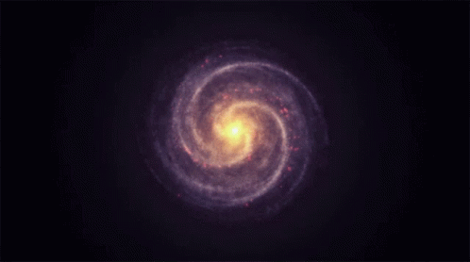
Inspiration
My inspiration for this projects topic is curiosity about life itself and understanding the unknown. My fascination with Earth and Space Science began in elementary school science class and has only grown stronger. I have since often looked up and wondered so many things. From books and movies to video games and NASA documentaries, this passion and curiosity has been shaped by a multitude of influences. This project is a great chance for me to dive deeper into astrometry data, align with my aspirations, and move closer to my goals in meaningfully contributing to space exploration.
Notes:
My inspiration for this projects topic is curiosity about life itself and understanding the unknown. My fascination with Earth and Space Science began in elementary school science class and has only grown stronger. Since then, I have often looked up and wondered so many things. From books and movies to video games and NASA documentaries, this passion has been shaped by a multitude of influences. This project is a great chance for me to dive deeper into astrometry data, align with my aspirations, and move closer to my goal of meaningfully contributing to space exploration.

Slide 3
What We Will Explore Here Today
Key terms to know before we start.
Which method has been most successful in detecting exoplanets?
How do the distances of stars detected by different detection methods compare?
How does exoplanet radius and mass vary with distance from the host star for different detection methods?
What factors might explain the apparent scarcity of exoplanets with extremely short orbital periods?
Recap on the key insights.
Notes:
Let’s take a look at what we will explore here today. We will start by getting familiar with some key terms. Then we will identify the most successful detection methods and briefly talk about them and how they work. After that we will see how the distances of stars detected by different detection methods compare. We will then look at how the mass and radius of a planet vary with distances for each method of detection. Finally, we will look into what factors could explain the lack of discovered exoplanets with extremely short orbital periods. To wrap it up we will recap on our key insights throughout the analysis.

Slide 4
Planet Mass: Is the total amount of matter a planet contains, essentially its "weight". (Jupiter Masses)
Planet Radius: The distance from the center of a planet to its outer surface, essentially representing the physical size of the planet. (Jupiter Radii)
Star Distance: The actual distance between a celestial body and its star at any given point in time. (AU)
Semi-Major Axis: The average distance between a planet and its star.
Orbital Period: Is the time it takes for a planet to complete one orbit around its sun.
Notes:
Here are some key terms to be familiar with before moving forward. Planet Mass: Is the total amount of matter a planet contains, essentially its "weight", and we measure this in jupiter masses.
Planet Radius: The distance from the center of a planet to its outer surface, essentially representing the physical size of the planet, measured in jupiter radii.
Star Distance: The actual distance between a celestial body and its star at any given point in time. Measured in astronomical units representing the distance from the Earth to the Sun.
Semi-Major Axis: The average distance between a planet and its star.
Orbital Period: Is the time it takes for a planet to complete one orbit around its sun. Now let’s go take a look at the detection methods!

Slide 5
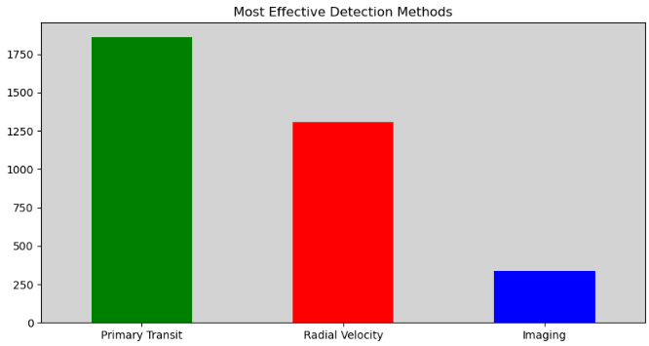

Notes:
There are a total of 3590 discovered exoplanets in the data worked with here. We can immediately see that the transit method is the most effective, the radial velocity method being the second, and Imaging clearly being the least effective of the 3. Let’s take a moment to briefly talk about the detection methods and how they work: Primary Transit: When a planet passes in front of its star from our point of view, it causes a small dip in the star’s brightness. By measuring this dip, we can learn about the planet’s radius, orbit, and sometimes its atmosphere. Radial Velocity: As a planet orbits its star, its gravity causes the star to wobble slightly. By measuring tiny changes in the star's light, we can detect the presence of a planet and figure out its mass and orbit. Imaging: In this method, we take pictures of exoplanets by blocking out the light from their parent stars. This allows us to directly observe the planet and study its atmosphere and other features. Which leads us to each detection methods usage over time.

Slide 6
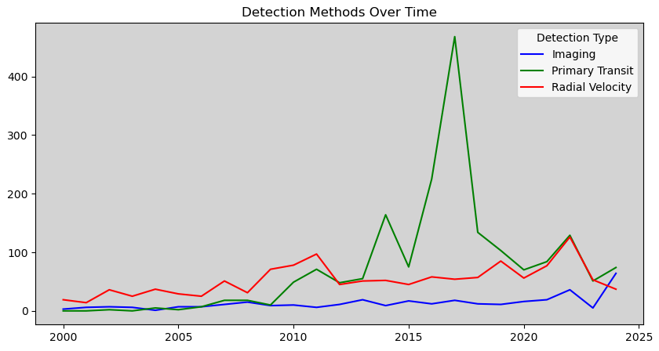
Notes:
For this analysis, we will focus on discoveries from years 2000 to 2024.
The graph shows a clear dominance of the Primary Transit method, particularly a sharp peak around 2017 which is most likely due to the success of the Kepler Space Telescope that was launched by NASA in 2009. While fluctuating, the Primary Transit method generally exhibits an upward trend across the depicted period. Radial Velocity demonstrates a more consistent but lower detection rate, with some fluctuations and a small peak around 2011 and another around 2022. Imaging consistently remains the least utilized method, showing a relatively flat trend with minor increases towards the end of the timeframe.
Overall we can see that technological advancements and observational strategies continue to be studied, produced, tested, and improved over the years with continued success.

Slide 7
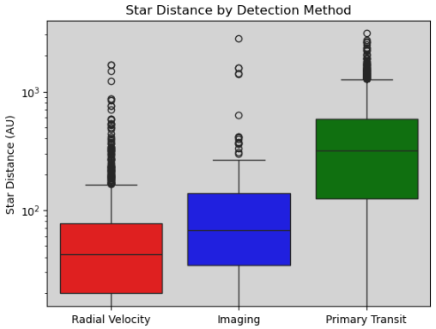
Notes:
Now that we've explored their use over time, let's take a closer look at where each detection method excels.
It is important before moving on from here that I mention the Logarithmic Scale. This kind of plot uses a special scale to show a huge range of numbers in a small space. Instead of counting by 1, 2, 3, etc., it counts by powers of 10 such as 1, 10, 100, 1000, 10,000 and so on. This box plot analysis reveals significant differences in the distance ranges at which exoplanets are detected by different methods. Imaging excels at finding closer stars, with a relatively narrow distribution, while Primary Transit and Radial Velocity methods demonstrate greater reach, detecting stars across a much wider range of distances, including numerous outliers. This suggests that while imaging is effective for nearby stars, transit and radial velocity methods are essential for exploring the more distant reaches of our galaxy. Let’s continue on to how radius and mass vary between methods and distance.

Slide 8
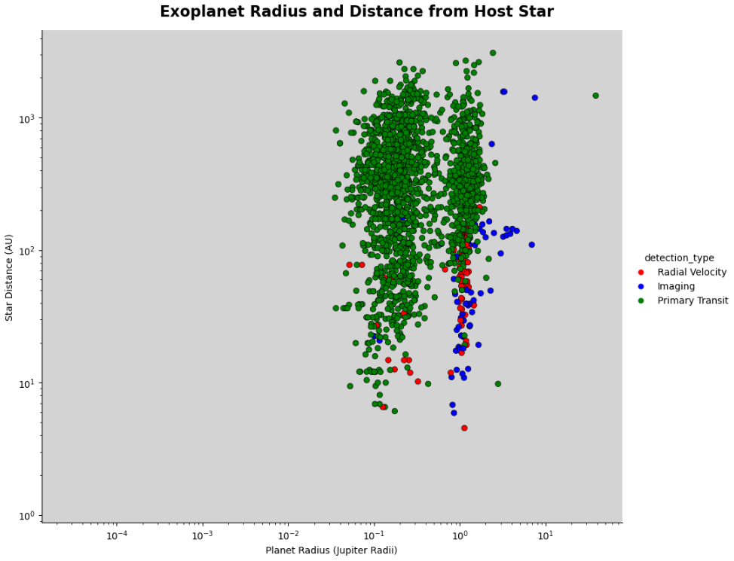
Notes:
First we will be taking a look at radius. The x-axis represents the planet's radius.
It starts off by showing us the majority of the plotted exoplanets with Primary Transit tend to be closer to their stars and have a wide range of radii.
Exoplanets detected by the Radial Velocity appear to have smaller radii and are distributed across a wider range of orbital distances.
The few that have been discovered using the Imaging method tend to be further from their stars and have slightly larger radii than those found by the other methods. Taking a look at the mass now..

Slide 9
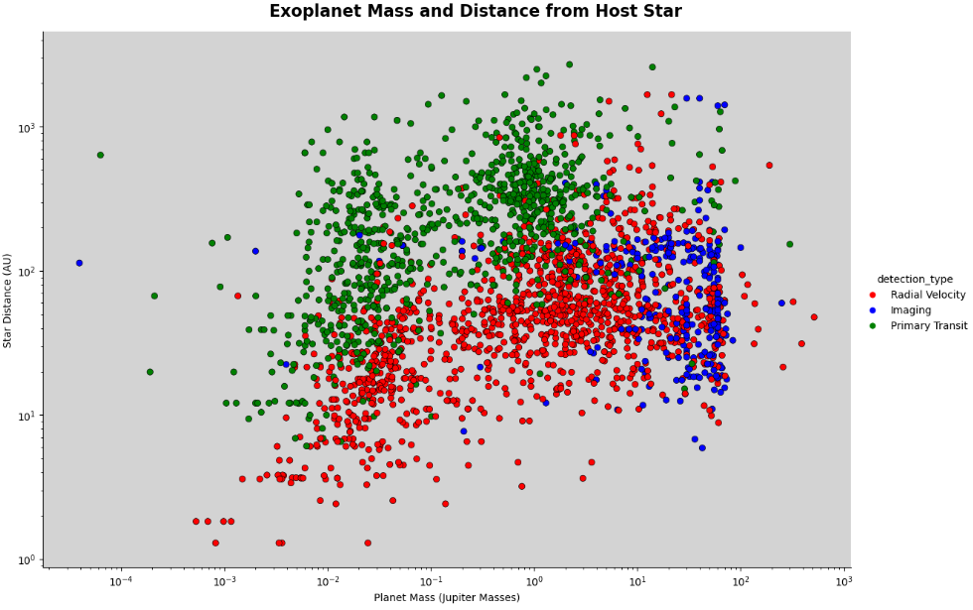
Notes:
The x-axis now represents the planet mass.
Radial Velocity tends to find planets with greater mass, while Transit prefers planets near their star, which result in more frequent and deeper transits. Imaging tends to detect planets that are distant from their stars. This is because planets that orbit close to their stars are typically outshined by the star itself. Imaging works best for detecting large, bright planets far from their stars where they can be separated visually from the glare of their host stars.

Slide 10
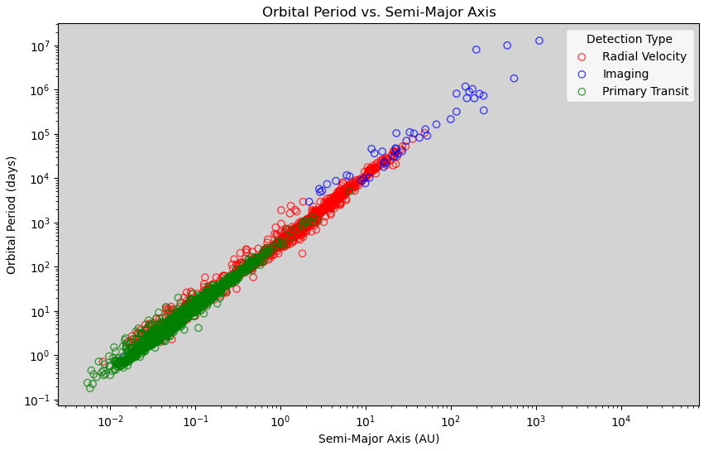
Notes:
Now we will take a look into planets with short orbital periods. If we look at the yellow line on the Y axis, this is the orbital period of 1 earth day. We can see that there are more planets above the orbital period of 1 day, than below it. One possible explanation is that our current scientific technology is not advanced enough to correctly measure planets that orbit in less than a day. In the lower left, we see that most of these planets were detected using the Transit method, and the other few observing with Radial Velocity. We also can see that Imaging is the most effective when the planet is further from its host star. But why is there no scatter in the top right corner? When trying to figure this out, I switched the detection type with the eccentricity and was able to understand why.

Slide 11
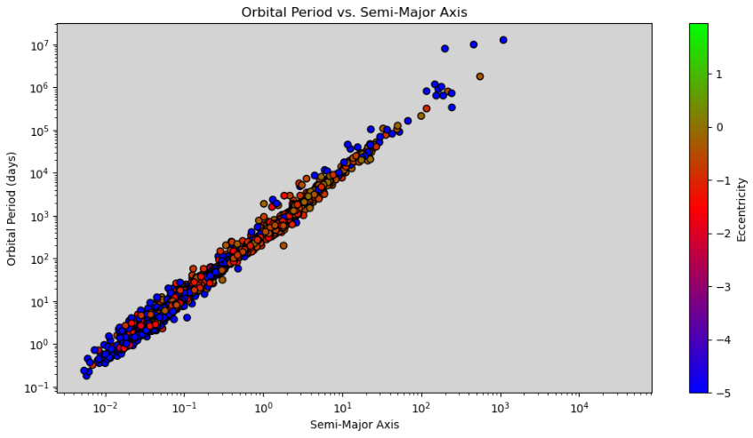
Notes:
Eccentricity measures how elongated an orbit is. This ranges from 0 (a perfect circle) to 1 (a highly elongated ellipse). Higher eccentricity means a more oval shaped orbit. Knowing that, we can now see the reason is the closeness of the planets to their stars. The blue colour indicates a low orbital eccentricity, meaning a more circular orbit. At small distances, the planets are subject to a stronger gravitational force by the host star, making their orbits more circular. They effectively become like the moon is to the earth: they get tidally locked and rotate in a circular motion. The orbits become more elliptical as the eccentricity increases. At low orbital eccentricity, it is harder to determine the Semi-major axis correctly.
This brings us to our conclusions.

Slide 12
In this presentation, we explored the unknown world of exoplanets, examining the strengths and limitations of various detection methods. This analysis revealed several key insights:
Method Dominance: The transit method has been the most prolific in discovering exoplanets, especially those orbiting close to their host stars.
Distance Reach: Imaging excels at detecting closer stars, while Primary Transit and Radial Velocity methods are capable of finding exoplanets across a wider range of distances, including those much further away.
Radius-Distance Relationship: Exoplanet radii vary significantly with distance from their host stars, revealing different detection methods are more sensitive to specific planet types.
Mass-Distance Distribution: The distribution of exoplanet masses and distances is influenced by detection biases, with radial velocity favoring massive planets and transit favoring smaller, closer planets.
Orbital Period Mystery: The scarcity of exoplanets with extremely short orbital periods remains puzzling. Future research may uncover the underlying reasons for this intriguing phenomenon.
As our understanding of exoplanets continues to evolve, we can anticipate groundbreaking discoveries that will reshape our perception of planetary systems and the potential for life beyond Earth.
Notes:
This presentation has explored the diverse landscape of exoplanet detection methods, highlighting their unique strengths and limitations. Our analysis revealed a clear dominance of the transit method, particularly for planets orbiting close to their host stars. We observed a distinct relationship between detection method, distance reach, and the types of exoplanets discovered. Notably, exoplanet radii exhibit a strong correlation with their distance from their host stars, while the distribution of exoplanet masses and distances is significantly influenced by the inherent biases of each detection technique. The scarcity of exoplanets with extremely short orbital periods remains a compelling mystery that demands further investigation. As our understanding of exoplanets continues to deepen, we anticipate groundbreaking discoveries that will revolutionize our perception of planetary systems and the potential for life beyond Earth. And that concludes my analysis! Thank you for your time. Are there any questions?

